Slide 1
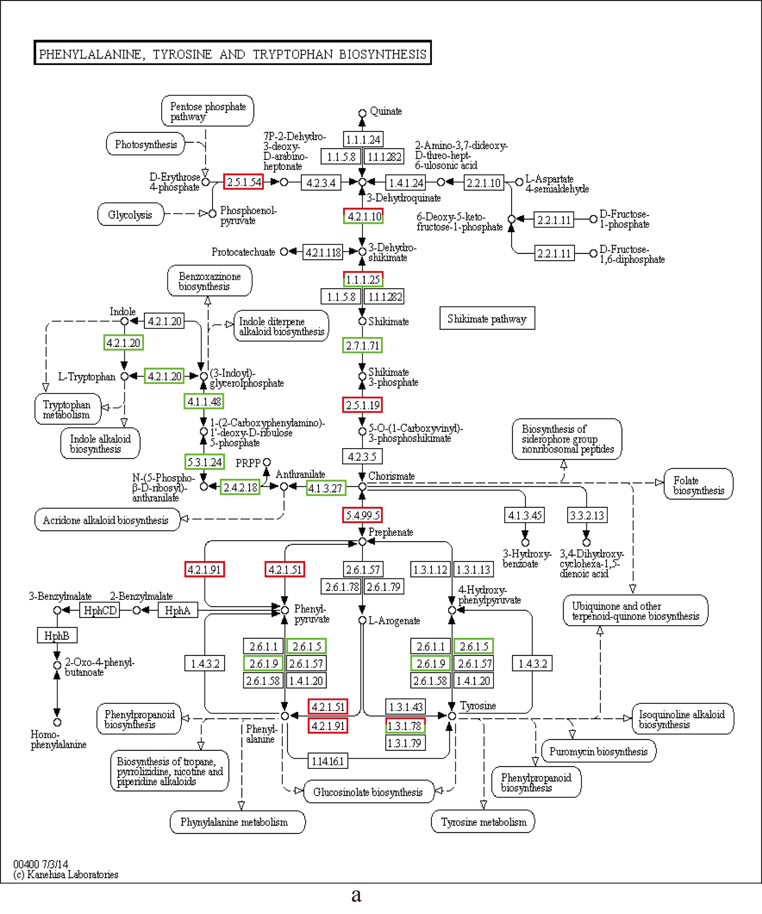
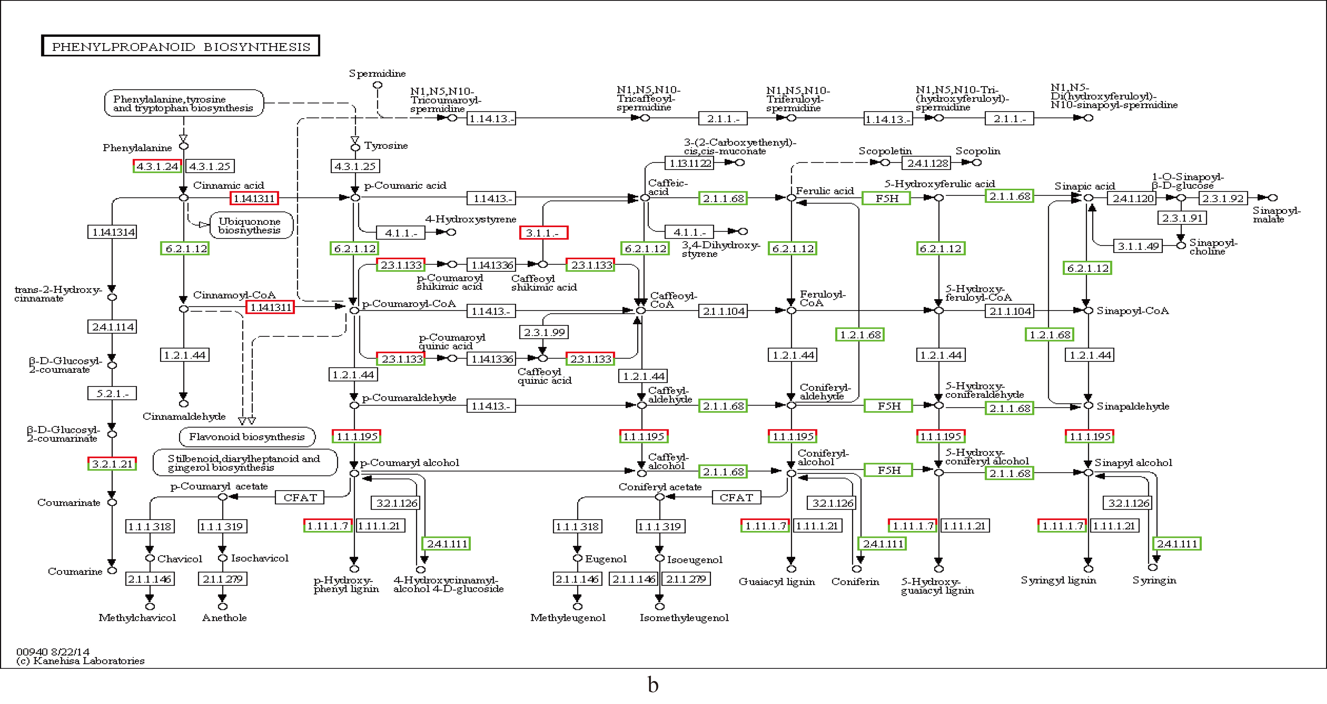
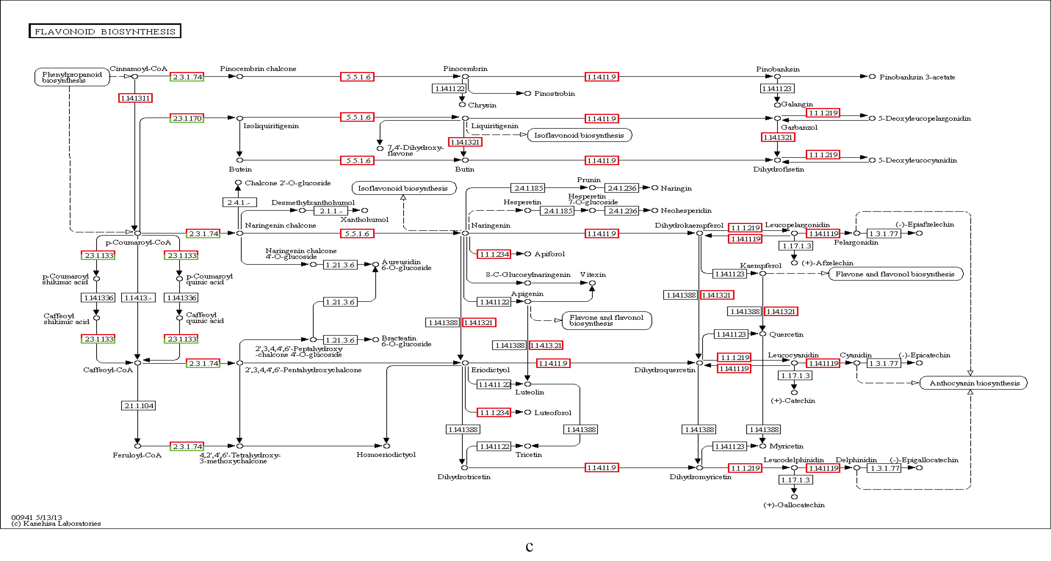
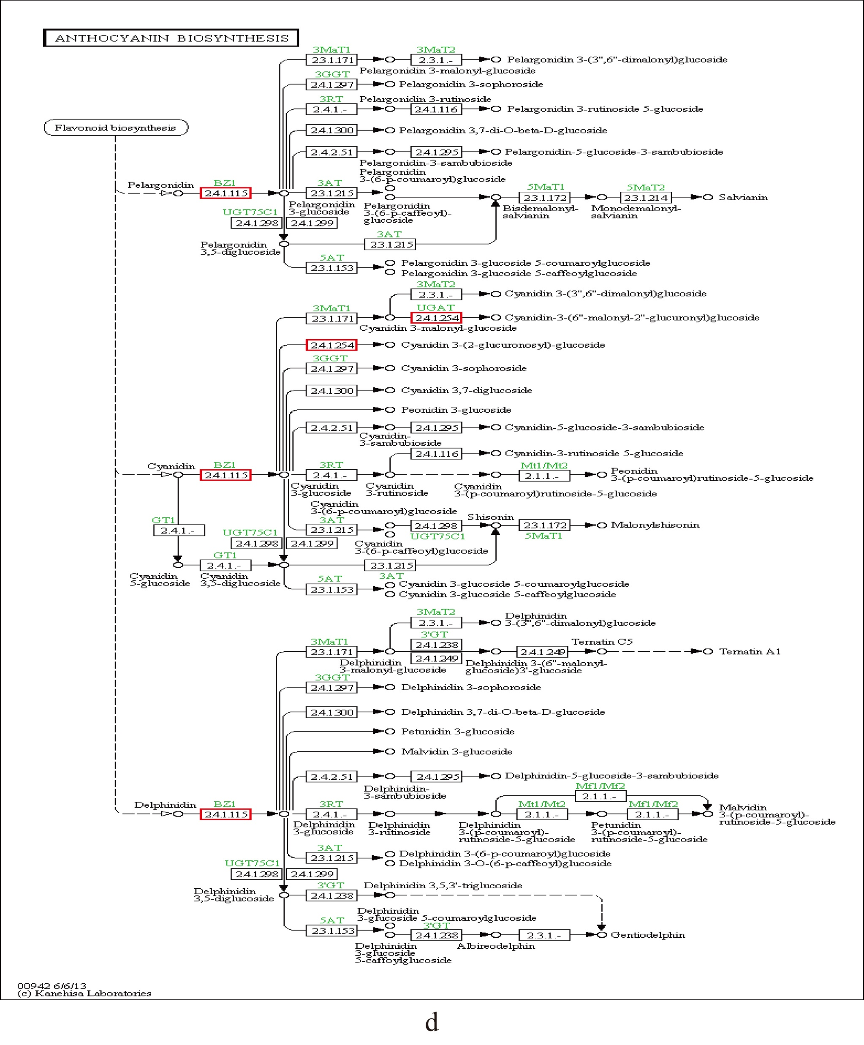
Figure S1. Biosynthesis pathway in mulberry fruit.
a. Phenylalanine, tyrosine and tryptophan biosynthesis.
b. Phenylpropanoid biosynthesis.
c. Flavonoid biosynthesis.
d. Anthocyanin biosynthesis.

